Slide 1
DEATH OF A CRAFTSMAN
@EINARWH

Slide 2
HELLO
Notes:
…So, hello everyone! Thank you for coming to my talk, and thanks for having me here at KanDDDinsky.

Slide 3
MY NAME IS EINAR
Notes:
My name is Einar. I work for NRK, which is the national public broadcaster in Norway. For a living, I design and write software. That is, you could call me a software developer, a coder, a programmer, and also a software designer, I guess. Those are all things I do and labels you could put on me.

Slide 4
I AM NOT A SOFTWARE CRAFTSMAN
Notes:
But I’m not a software craftsman. And this is a talk about why that is.

Slide 5
I AM NOT EVEN A SOFTWARE CRAFTER
Notes:
It’s actually worse. I’m not even a software crafter. Because you know, there is an awareness that maybe the label “craftsman” isn’t such a good label in an industry that has too few women. So that’s good, but I’m not really a crafter either. But I’m going to come back to that distinction repeatedly during this talk. I’m going to make a distinction between being a craftsman and being a crafter, because I think there’s a subtle difference. You could say that craftsmanship evolved into crafting. (It’s a bit difficult to talk about, because back when people first started talking about software as a craft, craftsmanship was the word people used. Now crafting is gaining ground, but there’s still a lot of talk about craftsmanship out there, due to a mixture of ignorance and stubbornness I guess.) But yeah. I’m neither.

Slide 6
THIS IS DIFFICULT
Notes:
All the same, I must say, this is pretty difficult, and I’m a bit nervous. This is probably the most difficult talk I’ve done.

Slide 7
(IS IT DANGEROUS?)
Notes:
All the same, I must say, this is pretty difficult, and I’m a bit nervous. This is probably the most difficult talk I’ve done.

Slide 8
AWKWARD!
Notes:
So this is perhaps awkward then. Because some of you here, maybe you consider yourselves crafters and here I am on stage saying I don’t. And you know, like, who’s right?

Slide 9
TENSION!
Notes:
There’s tension! And I don’t know if you share this impression, but my impression at least is that as a community, as an industry, even as a species, we’re not really great at handling tension. We’re much more comfortable when we all just agree. But I think that’s probably something we should challenge.

Slide 10
CLARIFICATION
Notes:
In particular it’s difficult because I don’t want to insult or belittle other people and the things they believe in. So I really want to clarify, this is not “death to all craftsmen”, “craftsmen are bad”, “craftsmen are stupid” or anything like that. In fact, and this is super super important, if you think of yourself as a crafter, and this gives you energy and inspires you, if it gives you the drive to improve and do better, that’s great. Never mind me! This talk is just about why *I* don’t think of myself as a software craftsman. That’s all. The title of the talk is taken from a stage play by Arthur Miller, called Death of a Salesman, which deals with identity crisis and the relationship between dreams and reality. So it seemed a fitting title for a talk about my own identity crisis. Now of course I wouldn’t be here if I didn’t think that some of the things I’m going to say is going to resonate with some of you, or at least trigger some reflection. But we’ll see.

Slide 11
ACKNOWLEDGMENT
Notes:
I also want to acknowledge all the great work done by many people who *do* identify as software craftsmen or software crafters. There are conferences and unconferences and meetups where people learn from and inspire each other. That’s great. I don’t want to belittle that. As they say, some of my best friends in the industry are software crafters. What’s more, we agree on a lot of things about software development. We follow many of the same practices.

Slide 12
I AM NOT A SOFTWARE CRAFTER
Notes:
And yet I am not a software craftsman, nor a crafter.

Slide 13
WHY NOT?
Notes:
Now the obvious question is, well, why not?

Slide 14
I USED TO BE A SOFTWARE CRAFTSMAN
Notes:
Well I used to be. I used to think of myself as a software craftsman. And at that time “craftsman” was the term that most people used, so I guess that was what I was.

Slide 15
A PERSONAL STORY
Notes:
So I’d like to tell you my personal story with crafting. Back in 2002, I was fresh out of the university with my Master’s degree in Computer Science and got my first job as a programmer. And I was delighted to learn of all kinds of interesting stuff concerning software development that wasn’t taught at the University. Agile obviously was the hot new thing that everyone was talking about. I remember attending a conference in 2003 and Kent Beck was there, Robert Martin, Ward Cunningham, Rebecca Wirfs-Brock, even Eric Evans. I worked hard and read a lot of books and blogs as well. It was exciting times. I was looking to prove myself I guess, looking for who I was as a programmer and software developer. I wanted to be good.

Slide 16
CRAFTSMANSHIP
Notes:
And then I heard about craftsmanship. I’m guessing I first read about it in The Pragmatic Programmer book. The title page with a woodworker’s tool on it, and the subtitle “from journeyman to master”. It resonated. I wanted to master programming. So you might say I tried on the craftsman’s cloak, and my god, it fit me! It looked good on me! It was home! I was a “journeyman” on my way to mastery. And of course I also liked this idea that craftsmanship seemed to solve the age-old question: is programming art or science? It was neither and both: it was a craft! I could be half scientist, half artist, and sort of make up the mix myself. Of course, what exactly that meant was a bit unclear, but it felt good.

Slide 17
EXPERIENCE
Notes:
Over time, I gained much practical experience with software development in practice, and the forces that influences it. I learned a lot about myself and about others. I learned about my capabilities and limitations, my strengths and weaknesses. I learned that my brain and my ability to understand complex code is finite, for instance. Not only that, it’s shrinking. I also learned that my self-discipline and my rationality are pretty fixed entities. I’m disciplined most of the time, rational most of the time, but not always. But that was OK, I could live with being human and a craftsman, even though I started to realize that I might not actually be able to level up indefinitely. But there was a bigger problem. I was starting to feel that there were vitally important things influencing the success and failure of the software I worked on that had nothing to do with craftsmanship. There were both things out of my control, and things that I could potentially influence, but that craftsmanship said nothing about.

Slide 18
IDENTITY CRISIS
Notes:
Eventually this lead to an identity crises. You might say that the cloak of craftsmanship was starting to itch and no longer felt right. So finally, I had to take it off. But of course, this left me with a dilemma. If I’m not a craftsman or a crafter, who or what am I then?

Slide 19
IS THERE LIFE BEYOND CRAFTSMANSHIP?
Notes:
I had to figure out if there is life beyond craftsmanship? And that sounds ridiculous perhaps, but there are reasons for this.

Slide 20
WHAT IS A GOOD DEVELOPER?
Notes:
Now a fundamental question for all software developers, whether we think of ourselves as crafters or something else, is what is a good developer?

Slide 21
AM I A GOOD DEVELOPER?
Notes:
And that’s an important question to answer, so that you can answer this question, which is even more important. Am *I* a good developer. Because this has to do with sense of worth. Am I valuable?

Slide 22
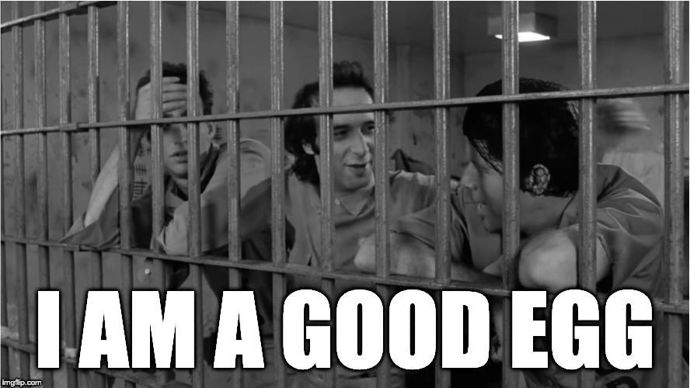
Notes:
Or as Roberto Benigni puts it, am I a good egg? We all want to be good eggs.

Slide 23
SOFTWARE CRAFTSMANSHIP PROVIDES ANSWERS
Notes:
And that was the original lure of software craftsmanship for me. Software craftsmanship provides answers to these questions, right? So that’s good.

Slide 24
WHAT IS SOFTWARE CRAFTSMANSHIP?
Notes:
And that was the original lure of software craftsmanship for me. Software craftsmanship provides answers to these questions, right? So that’s good.

Slide 25
SOFTWARE CRAFTSMANSHIP IS A MEME
Notes:
Software craftsmanship is a meme.

Slide 26
SOFTWARE CRAFTSMANSHIP IS AN IDENTITY
Notes:
Software craftsmanship is an identity.

Slide 27
SOFTWARE CRAFTSMANSHIP IS A NARRATIVE ABOUT SOFTWARE DEVELOPMENT
Notes:
It is an identity because it offers a narrative about software development. It offers a narrative about what matters in software development, and a way to distinguish yourself.

Slide 28
IT IS A NARRATIVE OF PRIDE AND PROFESSIONALISM
Notes:
It is a narrative that talks about pride and professionalism. You’ll find that craftsmanship and professionalism is used more or less as synonyms. In fact you can get the impression that craftsmanship is just a slightly kitchy word for professionalism. And this is actually quite sneaky and one of the things I don’t like so much. Because when you start to use those terms interchangeably, then suddenly you can’t be professional unless you’re a craftsman. I don’t like that, because it implies orthodoxy.

Slide 29
> THE CRAFTSMAN’S TALE <
Notes:
Well, let’s consider the craftsman’s tale.

Slide 30
IT IS A STORY OF HEROES AND ADVERSARIES
Notes:
It is also a narrative of heroes and adversaries. What do I mean by that?

Slide 31
WHO IS THE HERO OF SOFTWARE DEVELOPMENT?
Notes:
Who is the hero of software development in the craftsmanship narrative?

Slide 32
THE PROGRAMMER OF COURSE!
Notes:
Well it’s the programmer of course!

Slide 33
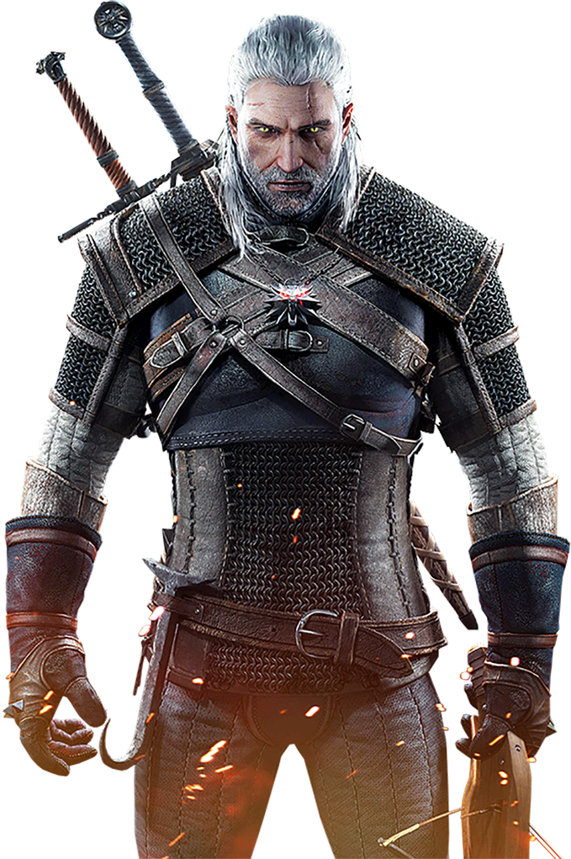
PRAGMATIC GOOD SOFTWARE CRAFTSMAN
Notes:
It’s this guy. The pragmatic good software craftsman, who relies on his skill and training and his own good judgment to do good in the world. Armed with TDD and SOLID, drilled through countless katas.

Slide 34
MASTERY OF THE CRAFT
Notes:
Being a good developer in the craftsmanship narrative means seeking mastery of the craft.

Slide 35
TECHNICAL EXCELLENCE
Notes:
Technical excellence. Flawless execution.

Slide 36
DISCIPLINE CAN FIX SOFTWARE
Notes:
Underlying is a belief that discipline can fix software. If we are just disciplined enough, we will do well.

Slide 37
BEST PRACTICES CAN FIX SOFTWARE
Notes:
If we follow the best practices we can fix software.

Slide 38
VIRTUE CAN FIX SOFTWARE
Notes:
Virtue can fix software.

Slide 39
I CAN SLAY THE DRAGON!
Notes:
I can slay the dragon!

Slide 40
IF I’M HIGH LEVEL ENOUGH THE SOFTWARE WILL BE GREAT
Notes:
So it all comes down to me. Me and my skills. If I’m good, the software is good. And in some ways, that’s a great, because it is within my power to determine the outcome.

Slide 41
IF THE SOFTWARE IS BROKEN IT IS MY FAULT
Notes:
Of course if that’s the case, then it also goes the other way around.

Slide 42
WRONG
Notes:
And this is where the cloak starts to itch for me. I think this is just wrong.

Slide 43
DANGEROUS
Notes:
And since it’s wrong, it’s also dangerous. Because now you have a narrative of software development that sells you a false promise and sets you up to feel bad about yourself. And you know Gerry Weinberg warned us about this 50 years ago, in the psychology of computer programming, when he warned us not to get our egos too attached to our code.

Slide 44
WHY?
Notes:
But why is it wrong? Isn’t it just the harsh, cold truth that if I fail, I’m not good enough? Shouldn’t I just face reality, accept the challenge, buckle down and work harder?

Slide 45
WHO MAKES SOFTWARE?
Notes:
Well, who makes software? That’s a trick question, right? We all know who makes software, right? It’s us, the programmers, we sit at the keyboard, we type the code, we test it, we ship it to production, it’s us? Surely it’s us! No one else can make software!

Slide 46
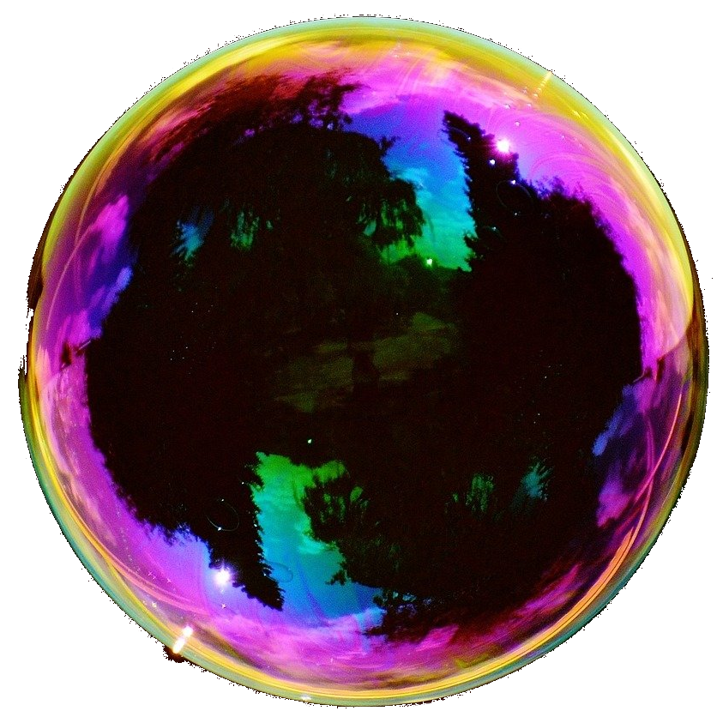
Notes:
This here is an illustration of the craftsman’s model of software development. Coding happens inside this bubble. You have a border of professionalism on the outside, and you have passion on the inside. It’s very inward-facing.

Slide 47
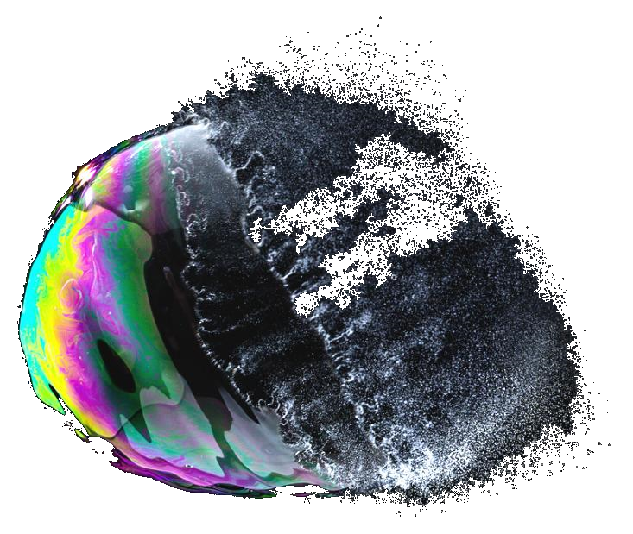
Notes:
The problem is that the border isn’t going to hold. The bubble is going to burst. No amount of skills or professionalism is going to change that. Because the forces you’re dealing with are much much stronger than that.

Slide 48
ORGANIZATIONS MAKE SOFTWARE
Notes:
The reason is that programmers don’t make software. Organizations make software. Conway’s Law is one expression of this. The health of the organization is an upper bound on the health of the code. Communication patterns, weak concepts, ambiguity, conflicts, conflict avoidance, all that is going to affect your code. To make good software, you need to direct your attention outward and work on the conditions for making software. You might still fail because there are many things beyond your control, but at least you’ve entered the playing field.

Slide 49
WHAT IS THE CRAFT?
Notes:
And a seemingly simple question is suddenly difficult. If organizations rather than programmers make software - What is the craft of making software? Is it coding? Deploying software? Or is it any just it using your skill, knowledge and influence to shape software? Because you can do that without writing code, can’t you?

Slide 50
WHO PERFORMS THE CRAFT?
Notes:
Who performs the craft? Who can be a software crafter? Who is the hero?

Slide 51
WHAT IS THE CRAFT MATERIAL?
Notes:
You know there’s an interesting dynamic when we program, when we write code, between our intent and the reality of the code. The code offers resistance to being formed, so we try different strategies, making tradeoffs. And that’s part of why the craft meme is so compelling to us. But that’s not the only malleable material involved in making software. There is also the organization itself that can be changed, as well as the business it engages in and the products it makes.

Slide 52
> THE CODE FETISH <
Notes:
Craftsmanship fails to see this because it is caught up in this fetish about code. Like the code is the only thing that matters. Everything else is noise and waste.

Slide 53
”THE CODE IS THE TRUTH”
Notes:
The code is the truth! And you have to say that in like a deep masculine voice.

Slide 54
THERE IS NO TRUTH IN THE CODE
Notes:
But there is no truth about anything interesting in the code.

Slide 55
THE CODE CAN ONLY TELL YOU WHAT IT DOES
Notes:
Apart from tautology. The code can only tell the truth about what the code does. For instance, it can’t tell you what it should have done, how to make users happy, how to provide value to someone, how to earn money. It can’t even tell you if it’s in production!.

Slide 56
THE CODE HAS NO DIRECTION
Notes:
We know that software is alive and changing, it’s organic, but the code at any given time doesn’t point in any particular direction. It has no idea of what’s going to happen next.

Slide 57
THE CODE DOESN’T WANT ANYTHING
Notes:
The code doesn’t want anything.

Slide 58
THE CODE IS NOT STRATEGIC
Notes:
It’s not strategic. It doesn’t have plans. It doesn’t know how to improve itself. It doesn’t know how to make priorities. But these are super-important things to talks about.

Slide 59
WHO CAN READ CODE?
Notes:
And you know, it’s sort of a passive-aggressive power trick as well. Because only we, the coders, can read the code. So if the code is the truth, then we are keepers of the truth, aren’t we. Not those other people. They might hold other kinds of power and prestige but they don’t wield the truth.

Slide 60
> ONE-DIMENSIONAL <
Notes:
Craftsmanship fails to see this because it is caught up in this fetish about code. Like the code is the only thing that matters. Everything else is noise and waste.

Slide 61
LINEAR LEVELING OF SKILL
Notes:
And you know, it’s sort of a passive-aggressive power trick as well. Because only we, the coders, can read the code. So if the code is the truth, then we are keepers of the truth, aren’t we. Not those other people. They might hold other kinds of power and prestige but they don’t wield the truth.

Slide 62
HIERARCHY OF PRACTITIONERS
Notes:
And you know, it’s sort of a passive-aggressive power trick as well. Because only we, the coders, can read the code. So if the code is the truth, then we are keepers of the truth, aren’t we. Not those other people. They might hold other kinds of power and prestige but they don’t wield the truth.

Slide 63
WHAT ABOUT SOFTWARE CRAFTING?
Notes:
Now I talked about software craftsmanship. How much of the things I just said applies to software crafting as well?

Slide 64
> THE CRAFTER’S TALE <
Notes:
How similar is the crafter’s tale to the craftsman’s tale.

Slide 65
THE PROGRAMMER IS STILL THE PROTAGONIST
Notes:
It’s less clear perhaps. There’s less machismo and less of that RPG vibe. But I’m going to say that the programmer is still the protagonist in the revisited narrative of software crafting. Now you might disagree with me, and I might be wrong.

Slide 66
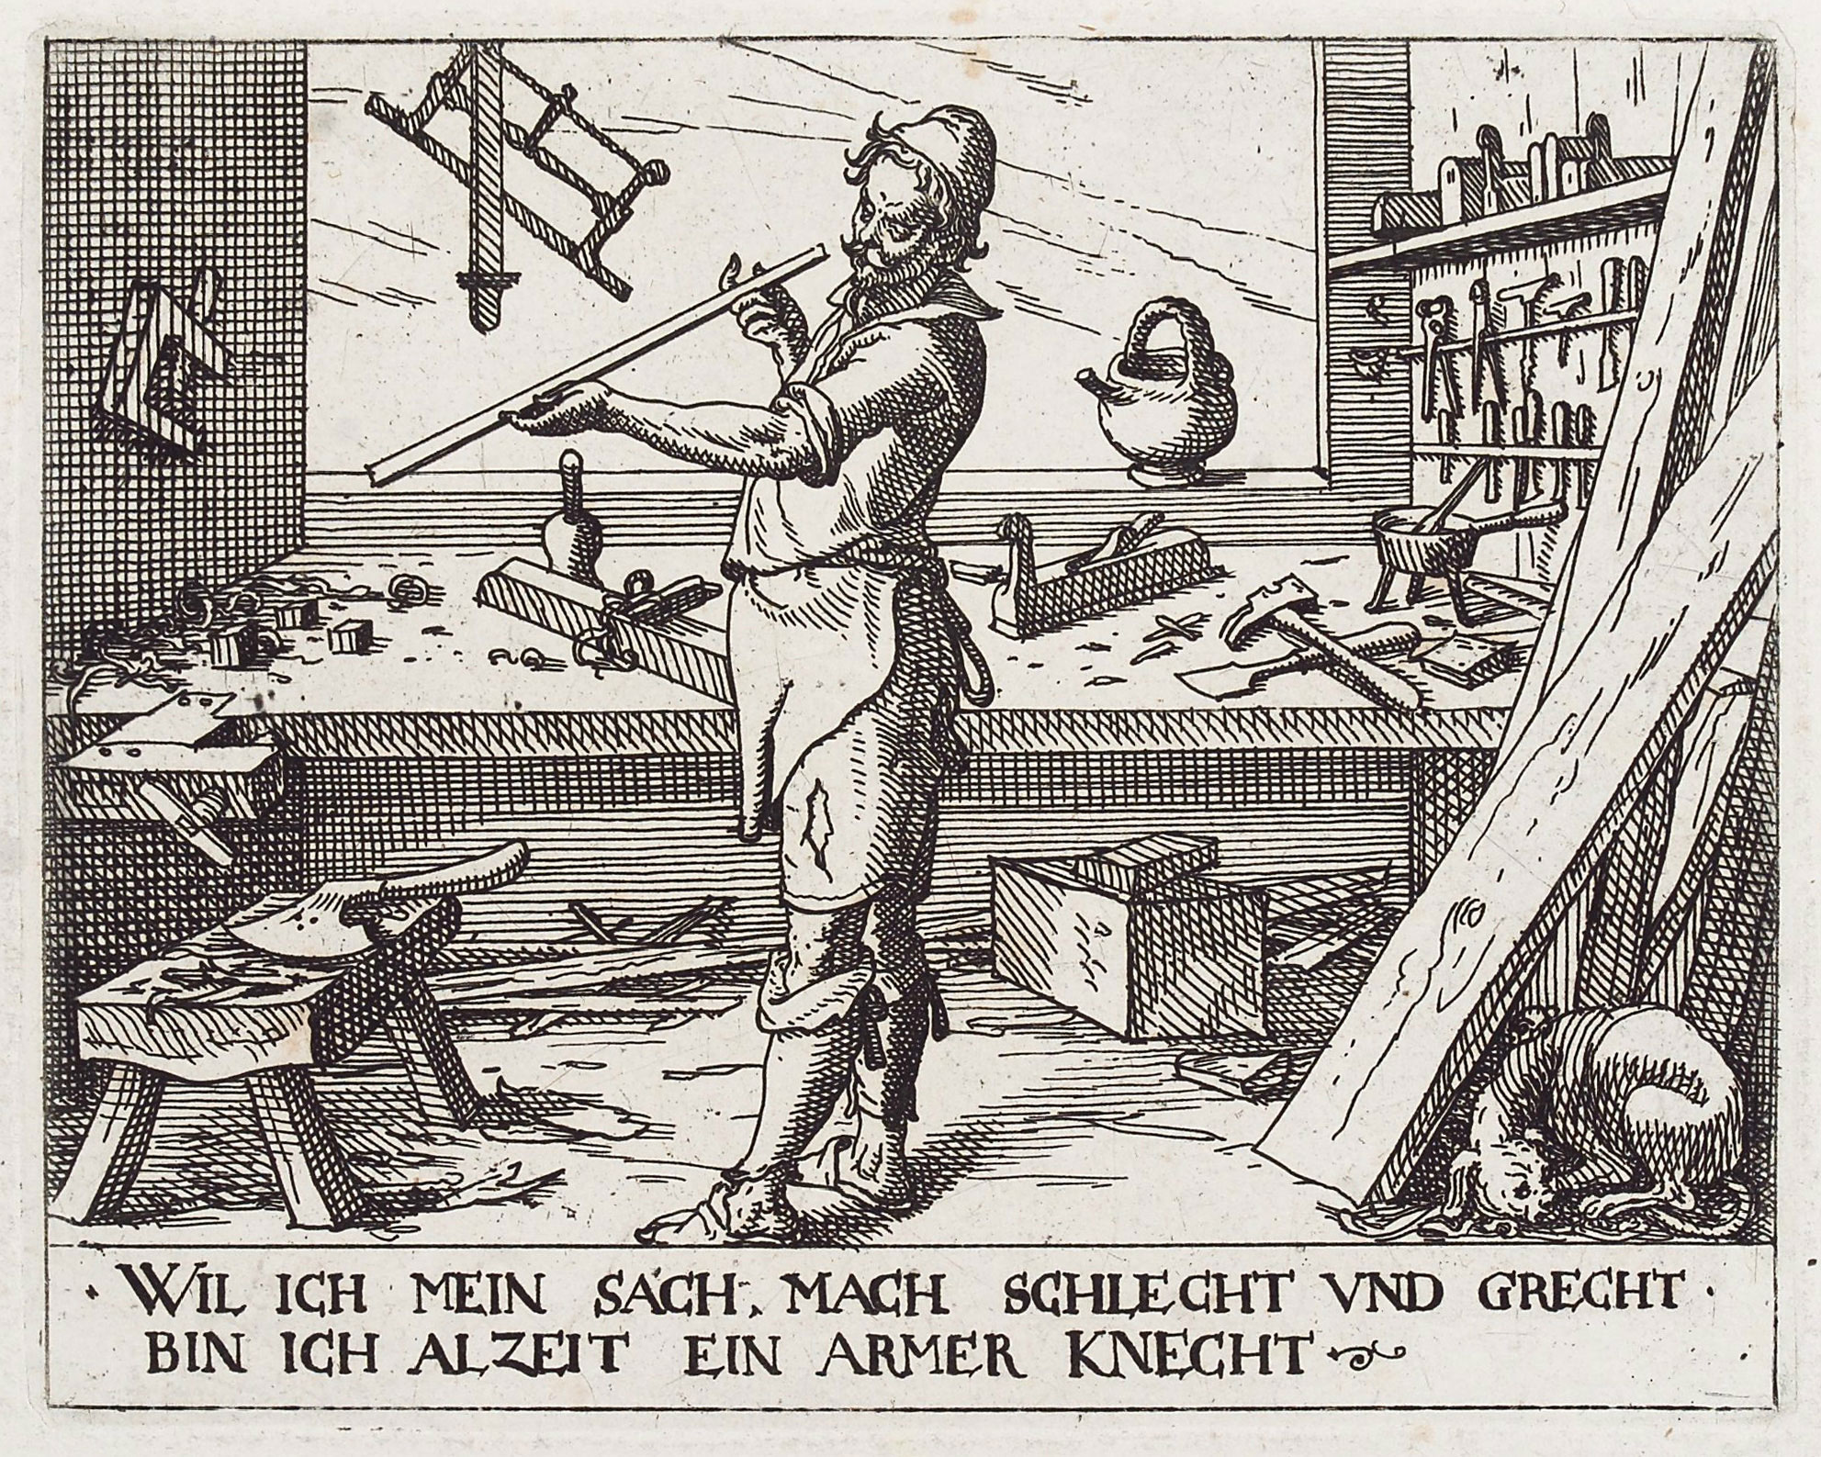
Notes:
And of course the medieval kitsch is very much intact.

Slide 67
> MONOPOLY ON VIRTUE <
Notes:
But since virtue is so important to craftsmen at least, and perhaps crafters as well,

Slide 68
THE THREE KINDS OF PROGRAMMERS
Notes:
In the craftsman’s tale, there are three kinds of programmers.

Slide 69
THE UNWASHED MASSES
Notes:
There are the unwashed masses, programmers who don’t care, who have no passion for programming, lazy, undisciplined filth! Apparently there are many of these, I personally haven’t met too many of them, lucky me.

Slide 70
THE UNWASHED MASSES BAD
Notes:
But these are bad. Obviously.

Slide 71
SOFTWARE CRAFTSMEN
Notes:
Then there are the software craftsmen.

Slide 72
SOFTWARE CRAFTSMEN GOOD
Notes:
These are good. By definition you might say. Could be an apprentice, could be a journeyman, could be a master, doesn’t matter, on the virtuous path!

Slide 73
IVORY TOWER ZEALOTS
Notes:
And then there are these.

Slide 74
IVORY TOWER ZEALOTS BAD
Notes:
These are terrible! They have passion but they use it all wrong! They have principles but they are wrong! They could be into category theory instead of patterns! They could be into formal verification, static typing and property-based testing in addition to unit tests! Proofs! Maths! They could be writing long methods, thinking abstractions should be deep!

Slide 75
BANISHED FROM THE REAL WORLD
Notes:
They must be banished from the real world

Slide 76
SOFTWARE CORRECTNESS
Notes:
Let’s take a topic that presumably all programmers care about, which is software correctness.

Slide 77
CRAFTSMANSHIP IS CONSERVATIVE
Notes:
Craftsmanship is really surprisingly conservative!

Slide 78
DO CRAFTSMEN QUESTION THEIR BELIEFS?

Slide 79
DO CRAFTSMEN WELCOME DIFFERENCES OF OPINION?

Slide 80
DO CRAFTSMEN LIKE THIS TALK?

Slide 81
DISAGREEMENT IS GOOD!
Notes:
I don’t know, but I think disagreement is good! We need disagreement!

Slide 82
DISAGREEMENT HAS ENERGY!
Notes:
I don’t know, but I think disagreement is good! We need disagreement!

Slide 83
TENSION!
Notes:
…

Slide 84
DISSONANCE!
Notes:
…

Slide 85
WHO ARE THE ADVERSARIES?
Notes:
Speaking of dissonance. Let’s backtrack. If the programmer is the hero in the craftsman’s tale about software, who are the adversaries? Apart from the ivory tower people.

Slide 86

Notes:
They look like this. The business. The suits. The accursed clueless managers. People who have never coded in their life! People who are also part of your organization.

Slide 87
RESPECT
Notes:
And you know, software craftsmen speak a lot about respect.

Slide 88
RESPECT
SELF
Notes:
But it seems pretty one-sided. I mean, it’s mostly about programmers respecting themselves. Which is fine and good and important.

Slide 89
RESPECT
LESS
Notes:
But it’s not so great when it means respecting others less. Have you seen and heard how craftsmen speak about non-programmers? It’s not pretty.

Slide 90
BUSINESS VS CRAFTSMAN
Notes:
So that’s not a very good way of forming productive partnerships. And you have this divide between the so-called business and the craftsman.

Slide 91
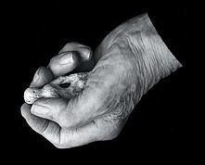
YE OLDE CRAFTSMAN’S SHOPPE
Notes:
The business people, the suits, can enter the craftsman’s shoppe, where everything is neat and tidy, a stronghold of sanity.

Slide 92
HAND-CRAFTED ARTISAN SOFTWARE MADE TO ORDER
Notes:
And there the business can order software of the highest quality, and maybe there’s some negotiation and the craftsman can offer alternatives at various costs, according to need.

Slide 93
COMMUNICATION BECOMES NEGOTIATION
Notes:
So it’s a client-supplier kind of relationship and communication becomes negotiation.

Slide 94
BUT WE ARE THE BUSINESS
Notes:
But we, developers, are the business, just as much as anyone else. There are no business people! There are other people doing things besides programming in the same business.

Slide 95
COMMUNICATION SHOULD BE COLLABORATION
Notes:
Software development is a cross functional team effort. And communication should be collaboration.

Slide 96
HOW TO BE VALUABLE?
Notes:
So how can we be valuable? How can we be good eggs?

Slide 97
BEYOND TECHNICAL SKILL
Notes:
I would like to see more programmers looking beyond technical skill.

Slide 98
DOMAIN MODELLING
Notes:
So in my work, I try to bring value by being doing domain modelling, because I believe that poor modelling and weak, ambiguous language is the primary cause of complexity and technical debt.

Slide 99
SYSTEMS THINKING
Notes:
You could be good a systems thinking, how complex systems interact.

Slide 100
STRATEGIC ARCHITECTURE
Notes:
You could do strategic architecture work, working iteratively to improve the architecture to support evolving business needs.

Slide 101
SO MANY VALUABLE SKILLS!
Notes:
There are so many valuable skills for a software developer besides writing code.

Slide 102
WHAT IS A GOOD DEVELOPER?
Notes:
Which brings us back to the original question.

Slide 103
AM I A GOOD DEVELOPER?
Notes:
Am I a good developer?

Slide 104
WHAT IS MY IDENTITY?
Notes:
What is my identity?

Slide 105
SOFTWARE INFIDELS
Notes:
I for one want to see more heresy, more software infidels!

Slide 106
SOFTWARE JESTERS
Notes:
Perhaps even software jesters.

Slide 107
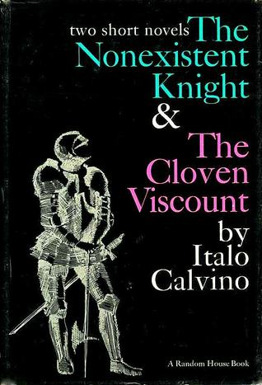
Notes:
I would like to leave you with a book recommendation. There’s a great story by Italo Calvino called the non-existent knight. It was written in 1959, but it’s clearly about software development.

Slide 108
SIR AGILULF
Notes:
The main character is Sir Agilulf Emo Bertrandin of the Guildivern.

Slide 109
THE PERFECT KNIGHT
Notes:
He is the perfect knight in white armor, he knows all the duties and routines and keeps everything clean.

Slide 110
AN EMPTY ARMOR
Notes:
The only problem is that he doesn’t exist, there’s no body inside the armor. When he takes off his armor, he disappears. So whether or not we are software craftsmen, I think it’s important that we think about what our identities should be, and if we really need that armor.

